Slide 1

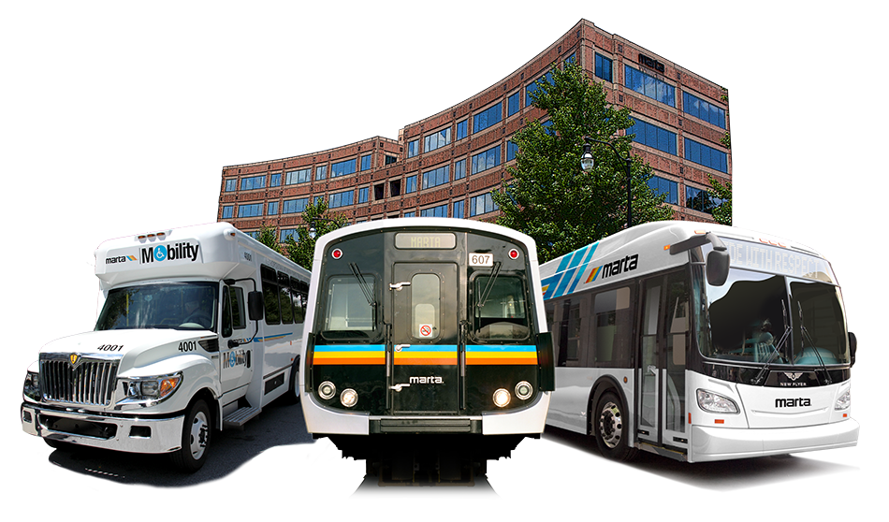
Treasury - MAX Presentation
Kevin L. Hurley, Treasurer
April 16, 2018

Slide 2
Presentation Outline
MARTA Governance
MARTA Tax Distributions
Operating Sources and Uses
Capital Sources and Uses
Financial Performance
Questions

Slide 3
I. MARTA Governance

Slide 4
Governance
Experienced oversight and governance…
THE METROPOLITAN ATLANTA RAPID TRANSIT OVERVIEW COMMITTEE (MARTOC)
Joint (House/Senate) committee, comprised of 12 legislators
________________________________________________________
Board of Directors
Chairman Robert L. Ashe III
  Thirteen voting members representing Clayton, DeKalb and Fulton Counties, the City of Atlanta and a Governor Appointee
City of Atlanta (3) DeKalb County (4) Governor (1)
Fulton County (3) Clayton County (2)
  Two ex-officio members appointed by the State of Georgia
    GDOT (non-voting) (1) GRTA (non-voting) (1)
Notes:
Provides strong oversight and partnership. Strong visionary leadership.

Slide 5
Governance
C-Team
Name | Title | Joined MARTA
Jeffrey A. Parker | General Manager/Chief Executive Officer | 2018
A. Robert Troup | Deputy General Manager | 2017
Rich Krisak | Chief Operating Officer | 2008
Gordon L. Hutchinson | Chief Financial Officer | 2013
Elizabeth M. O’Neill | Chief Counsel | 1995
Goldie Taylor | Chief Marketing & Communications Officer | 2017
Rukiya S. Thomas | Chief of Staff | 2013
Notes:
Provides strong oversight and partnership. Strong visionary leadership.

Slide 6
II. MARTA Tax Distributions

Slide 7
Tax Distribution
Bondholders benefit from a broad & balanced sales tax base…
1% Sales Tax collected from Clayton, DeKalb, and Fulton Counties and 1.5% Sales Tax collected from City of Atlanta*
Vehicle TAVT received from Clayton, DeKalb & Fulton Counties
Broad and balanced - low reliance on volatile sectors
Source: Georgia Department of Revenue, June 2017
* City Sales Tax rate increased ½% to 1.5% March 2017

Slide 8
Tax Distributions
Increasing tax receipts…
MARTA Tax Revenue
Actual
Forecast
Millions
  Tax revenue inclusive of Sales Tax and Vehicle TAVT
  Forecast growth in Sales Tax provided by Georgia State University
  Economic Forecasting Center – March 2017
Clayton County tax receipts began in March 2015
City of Atlanta ½ % Sales Tax rate increase began in March 2017

Slide 9
Flow of Tax Distributions
Bondholders receive priority payment…

Slide 10
III. Operating Sources and Uses

Slide 11
Operating Sources of funds
FY18 Operating Budget Sources - $471.5M …

Slide 12
Operating uses of Funds
FY18 Operating Expense Budget $461.5M …

Slide 13
IV. Capital Sources and Uses

Slide 14
Capital sources of Funds
FY18 Capital Improvement Program Sources $442.2M…

Slide 15
Capital uses of funds
FY18 Capital Expense Budget - $434.9M…

Slide 16
V. Financial performance

Slide 17
Operating Performance
Strong operating performance…
Positive trajectory of operational performance since FY13

Slide 18
RESERVE BALANCEs
Reserve positions will continue to grow…

Slide 19
2017 RESERVE BALANCE
Reserve position by liquidity…

Slide 20
Debt Principal OUTSTANDING
Debt level remains stable…..

Slide 21
Tax Distributions
Increasing tax receipts…
MARTA Tax Revenue
Actual
Forecast
Millions
  Tax revenue inclusive of Sales Tax and Vehicle TAVT
  Forecast growth in Sales Tax provided by Georgia State University
  Economic Forecasting Center – March 2017
Clayton County tax receipts began in March 2015
City of Atlanta ½ % Sales Tax rate increase began in March 2017

Slide 22
Debt Service Coverage
Improving Debt Service coverage ratios…
Note: Chart assumes a $100 million borrowing in FY2018

Slide 23
Positive Results
Benefits Continue…
Highlights
Five consecutive years with operating surplus and strong tax collections
City of Atlanta ½ % Sales Tax increase adds more pledged revenue to bondholders
  MARTA Maintains Strong Credit Ratings
    S&P AA+ - Moody's Aa2
Significant growth in support for public transit
  Atlanta Regional Business Leaders and Community
  Relocation of Large Corporate Business Headquarters and Operations Centers in close proximity to MARTA Rail Lines
Legislative changes have enhanced revenue and flexibility
  Positive State of Georgia Bipartisan Government Actions – bring more opportunity
  Two state grants (SRTA ) totaling $31.7M

Slide 24
VI. Questions

